Slide 1
Project Title : IOT Based Patient Health Monitoring on ESP32 Web Server
Course Code: | COE3102 | Course Name: | MICROPROCESSOR AND EMBEDDED SYSTEMS
Course Teacher: Md. Shaoran Sayem
Lecturer
Department of Electrical and Electronic Engineering
SL # | Students ID | Students Name | Program | Section
1 | 22-46013-1 | MD. SHOHANUR RAHMAN SHOHAN | BSc in CSE | J
2 | 19-39640-2 | MD. ASHIKUZZAMAN ABIR | BSc in CSE | J
3 | 22-47010-1 | MD. JAHID HASAN | BSc in CSE | J
4 | 22-47018-1 | FARJANA YESMIN OPI | BSc in CSE | J
5 | 22-47019-1 | MD. ABU TOWSIF | BSc in CSE | J
6 | 22-47048-1 | A. F. M. RAFIUL HASSAN | BSc in CSE | J

Slide 2

Objectives of the Work
To develop --- (to write objectives use some specific action verbs that are realizable)
To implement --
To incorporate --
To analyze –
To design --
To simulate –
To test --
To validate --

Slide 3
Introduction
Background information, motivation behind doing this work is to be described here in 2-3 slides
Please don’t describe too much, use bullets/numbers to present your points of discussions
Please use 28-36 font size so that these are visible from far by the audiences
It is better to use alternate colors in different lines

Slide 4

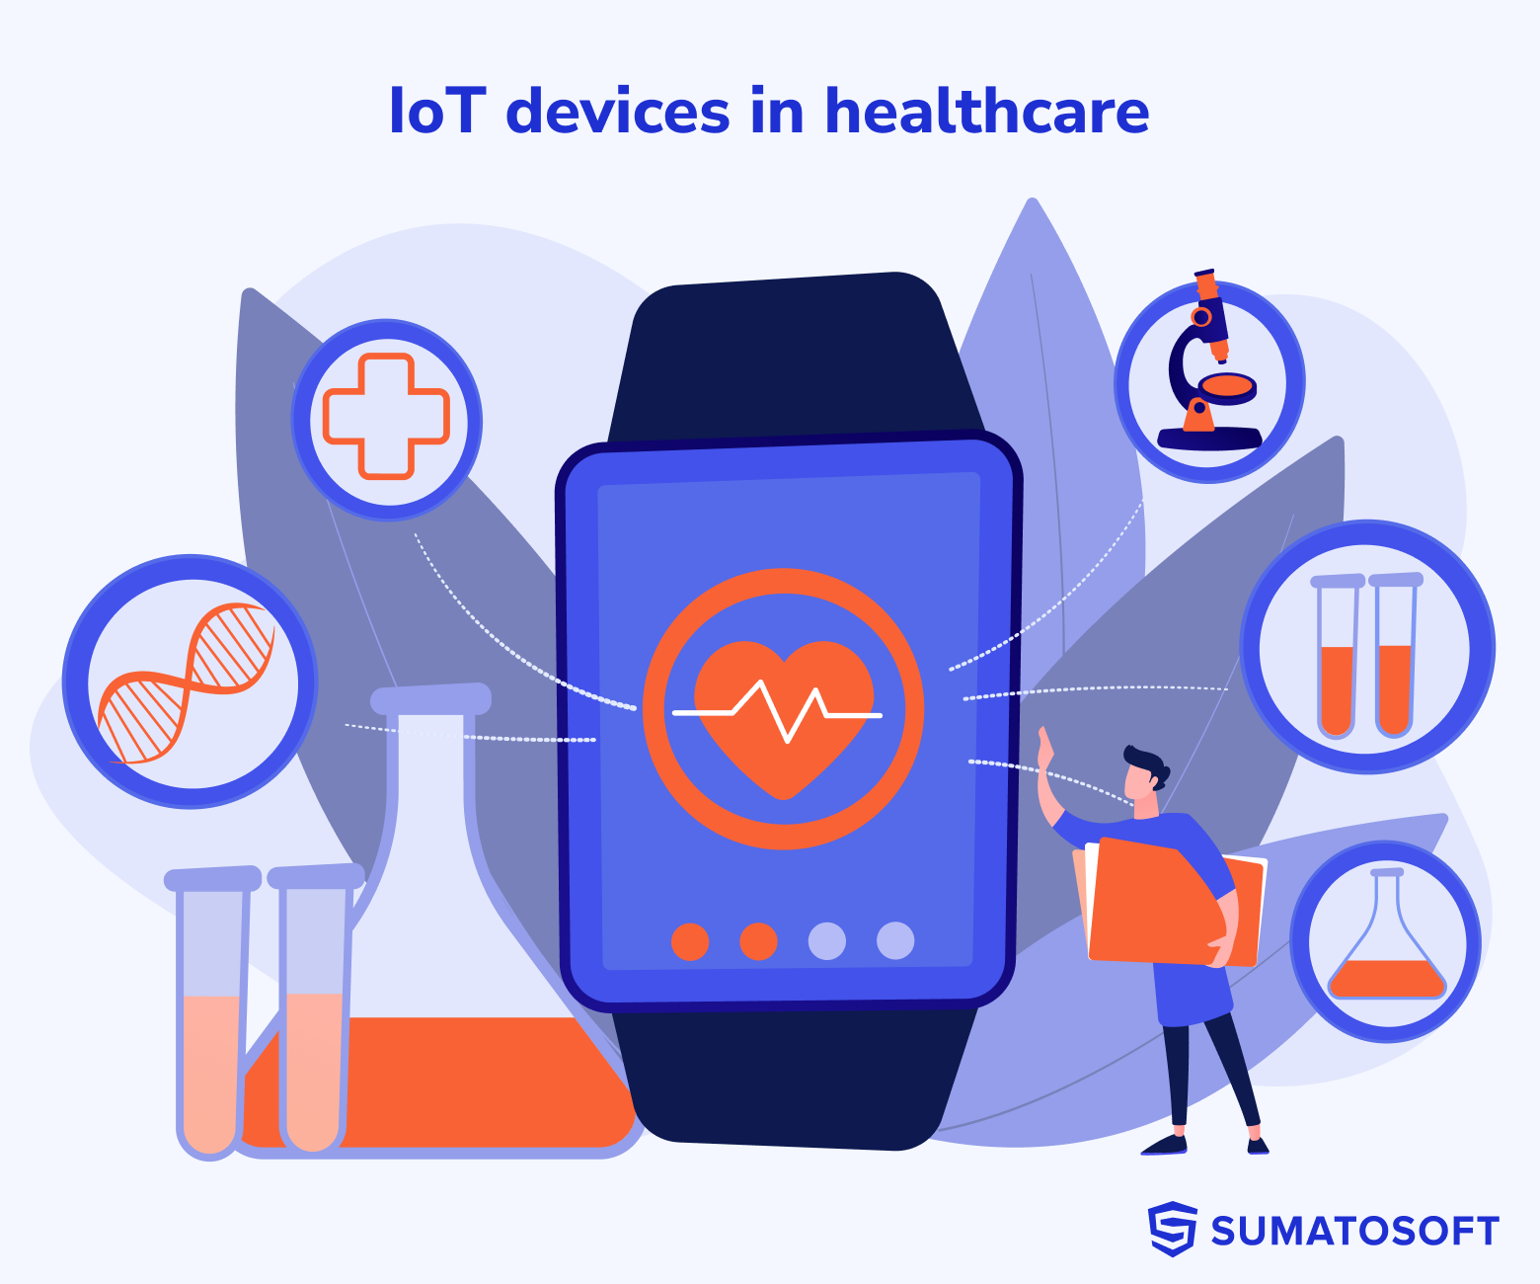
Literature Review
Introduction to IoT in Healthcare
In recent years, the integration of IoT technology into healthcare systems has garnered significant attention for its potential to revolutionize patient monitoring. IoT-enabled systems facilitate remote monitoring of patient health parameters, offering real-time data collection and analysis for improved healthcare outcomes
Significance and potential of IoT to revolutionize
healthcare systems
The seamless integration of IoT technology into healthcare not only improves the quality of patient care but also reduces healthcare costs and enhances overall efficiency. IoT-enabled healthcare systems enable proactive intervention, personalized care delivery, and remote patient monitoring, transforming traditional healthcare practices.

Slide 5
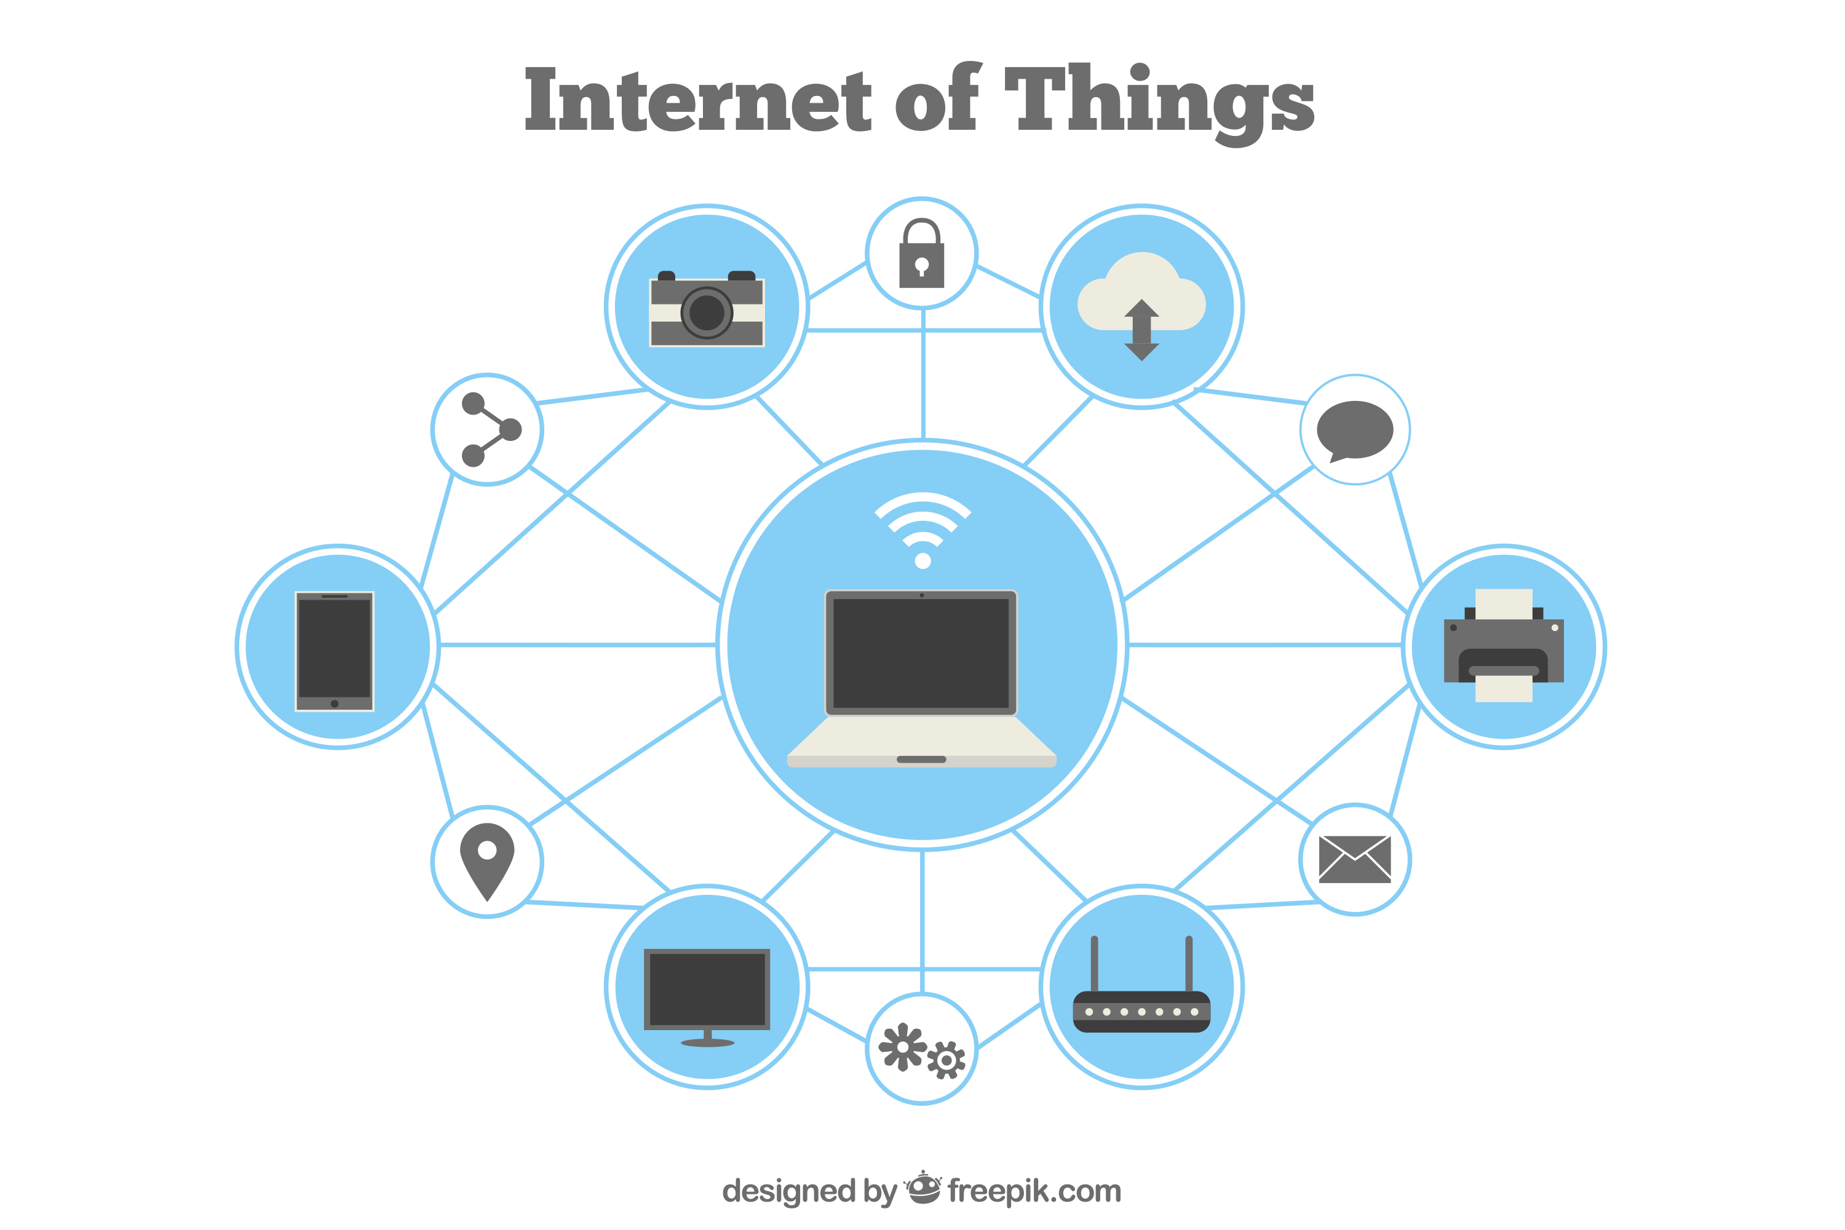
Literature Review
Existing Approaches in IoT-based Patient Health Monitoring
Existing research has explored various approaches to IoT-based patient health monitoring, showcasing a range of innovative solutions. Wearable IoT devices equipped with sensors continuously monitor vital signs, while cloud-based patient monitoring systems enable remote access to patient data for healthcare professionals.
Wearable IoT devices equipped with sensors offer a convenient and accessible way to continuously monitor vital signs such as heart rate, blood pressure, and body temperature. These devices enable real-time monitoring of patient health parameters, facilitating timely intervention and personalized care delivery.
Cloud-based patient monitoring systems leverage platforms like Raspberry Pi to enable remote access to patient data for healthcare professionals. These systems facilitate seamless communication and collaboration, enhancing the efficiency and effectiveness of healthcare delivery.

Slide 6
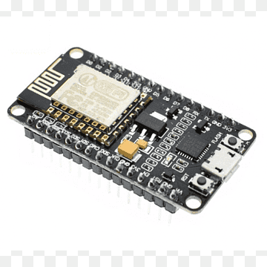
Literature Review
Advancements in Microcontroller Technology
and Gap in Literature
Recent advancements in microcontroller technology, such as the ESP32 microcontroller, have opened new possibilities for remote patient monitoring. The ESP32 microcontroller offers built-in Wi-Fi and Bluetooth connectivity, enabling seamless data transmission and communication in patient monitoring systems
Example study:
"ESP32 Microcontroller-Based Remote Health Monitoring System" (Journal of Medical Internet Research, 2022)
The paper "ESP32 Microcontroller-Based Remote Health Monitoring System" showcases the potential of utilizing microcontrollers like the ESP32 for real-time health monitoring applications. This study highlights the capabilities of the ESP32 microcontroller in facilitating remote patient monitoring and data transmission

Slide 7
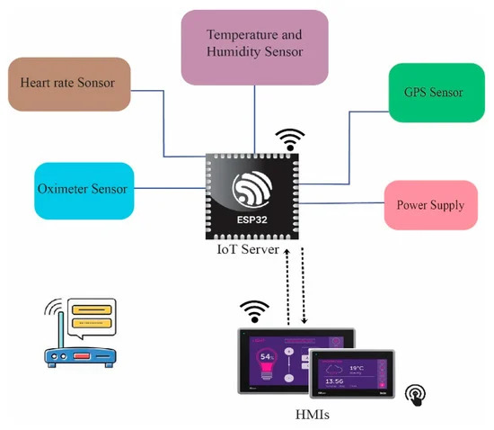
Working Method
Working Principle
The IoT-based Patient Health Monitoring project utilizes ESP32 development kits to monitor vital signs like pulse rate, temperature, and SpO2 remotely. ESP32 serves as both sensor controller and server, enabling real-time data processing and transmission via Wi-Fi to a web server. Healthcare professionals can access patient data stored in a centralized database from smart devices anywhere. Real-time alerts notify of abnormalities, enhancing timely interventions. This integration addresses challenges in IoT-based healthcare monitoring, advancing its adoption in real-world settings.
System Architecture

Slide 8
Working Method
Progress of work:
Wearable sensors continuously monitor vital signs (heart rate, temperature, SpO2).
The ESP32 development kit on the wearable device transmits the sensor data securely via Wi-Fi.
The data is received by a web server and stored in a centralized database.
Healthcare professionals can access patient data remotely through any smart device.
The system generates real-time alerts for any abnormal readings, enabling timely interventions.
This system offers remote patient monitoring, reducing in-person visits and improving healthcare efficiency.

Slide 9
Description of the Work
Use 2-3 slides to describe your work with photographs, figures, tables etc.
In case of continuation of same titled slides use triple dots (…) at the end of the slides but not in the last one

Slide 10
Description/Methodology of the Work
Use 2-3 slides to describe your work with photographs, figures, tables etc. such as, in these slides there are not triple dots in the end
To change the header or footer contents, please go to View Menu then click on to Slide Master and again go to View Menu then click on to Slide Master. Now you are able to change any contents from the bottom right text box. Finally, from the Slide Master Menu click on the Red Cross button at the right to close that View.

Slide 11
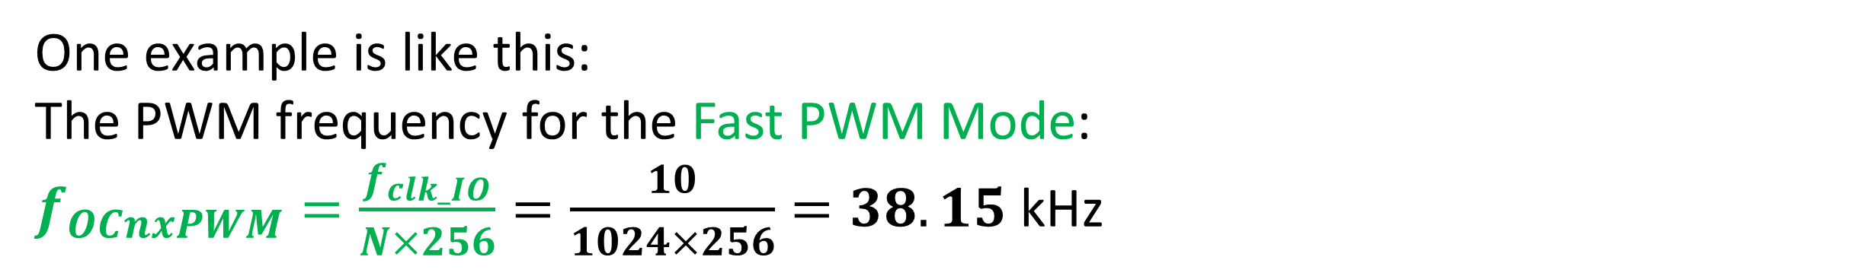
Equations/Mathematical Model
Must use equation editor to present equations. Values must be inserted to show the sample calculations.
One example is like this:
The PWM frequency for the Fast PWM Mode:
$f_{OCnxPWM}=\frac{f_{clk_IO}}{N×256}=\frac{10}{1024×256}=38.15$ kHz

Slide 12


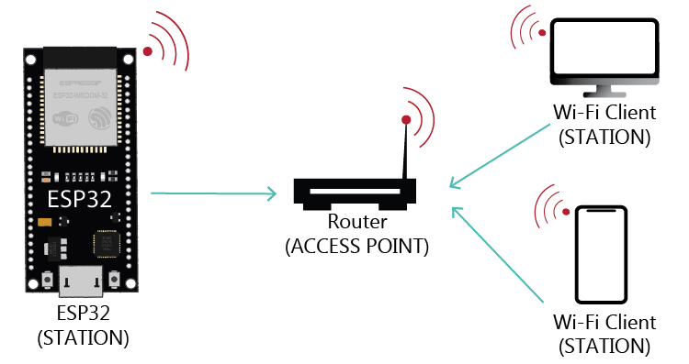
Results and Discussions
Results
The ESP32 successfully connects to the designated Wi-Fi network, and upon successful connection, it obtains an IP address, which is displayed on the serial monitor.
The system accurately measures and displays various health parameters, including room temperature, room humidity, heart rate (BPM), blood oxygen level (SpO2), and body temperature. These readings are obtained using the MAX30100 pulse oximeter sensor, DHT11 humidity & temperature sensor, and DS18B20 temperature sensor.

Slide 13
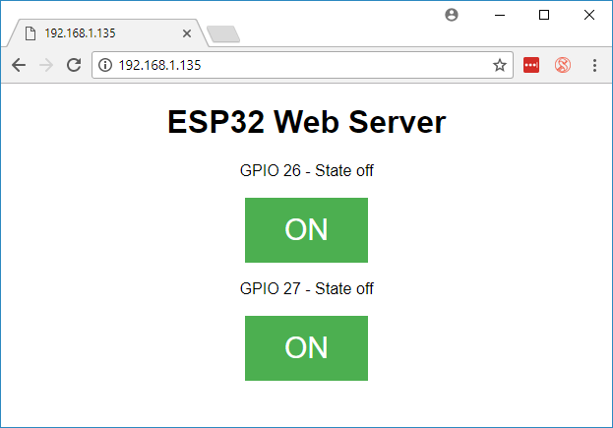
Results and Discussions
Results
Upon entering the IP address of the ESP32 into a web browser, a user-friendly web page is displayed. This page showcases the real-time health status of the patient, making it convenient for caregivers or medical professionals to monitor remotely.
The system is compatible with mobile devices, allowing users to access the patient's health status via a web browser on their smartphones or tablets.

Slide 14

Results and Discussions
Discussions
The accuracy and reliability of the sensor readings are crucial for effective patient monitoring. The MAX30100 pulse oximeter sensor, DHT11 humidity & temperature sensor, and DS18B20 temperature sensor are chosen for their precision and consistency in measuring vital health parameters.
The ability to monitor patient health status in real-time is a significant advantage of this IoT-based system. Caregivers or medical professionals can promptly respond to any abnormalities or emergencies based on the live data provided by the system.
By hosting the health monitoring interface on a web server, the system ensures accessibility from any device with a web browser and internet connection. This accessibility enhances convenience for caregivers and enables remote monitoring of patients, even from a distance.

Slide 15
Results and Discussions
Discussions
The user interface of the web page is designed to be intuitive and easy to understand. Clear and concise presentation of health parameters facilitates quick interpretation of data, enabling efficient decision-making by caregivers or medical professionals.
The system can be scaled up to accommodate additional features or sensors for comprehensive patient monitoring. Future enhancements may include integration with mobile applications, data analytics for trend analysis, and alerts/notifications for critical health conditions.

Slide 16
Conclusions
Conclude with in 1-2 slides

Slide 17
Future Scopes
List your future works that you want to present during your final presentation in 1 slide.

Slide 18
Thanks for listening our presentation….
?

